Slide 1
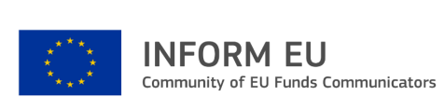
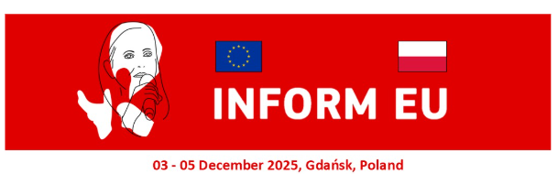
From projects about people to stories with people:
how we involve final beneficiaries in communication
VULNERABLE PEOPLE: HEALTH AND ART
Loredana Mizzoni - Chiara Giusti - Lucio Lussi
Italian Ministry of Health

Slide 2
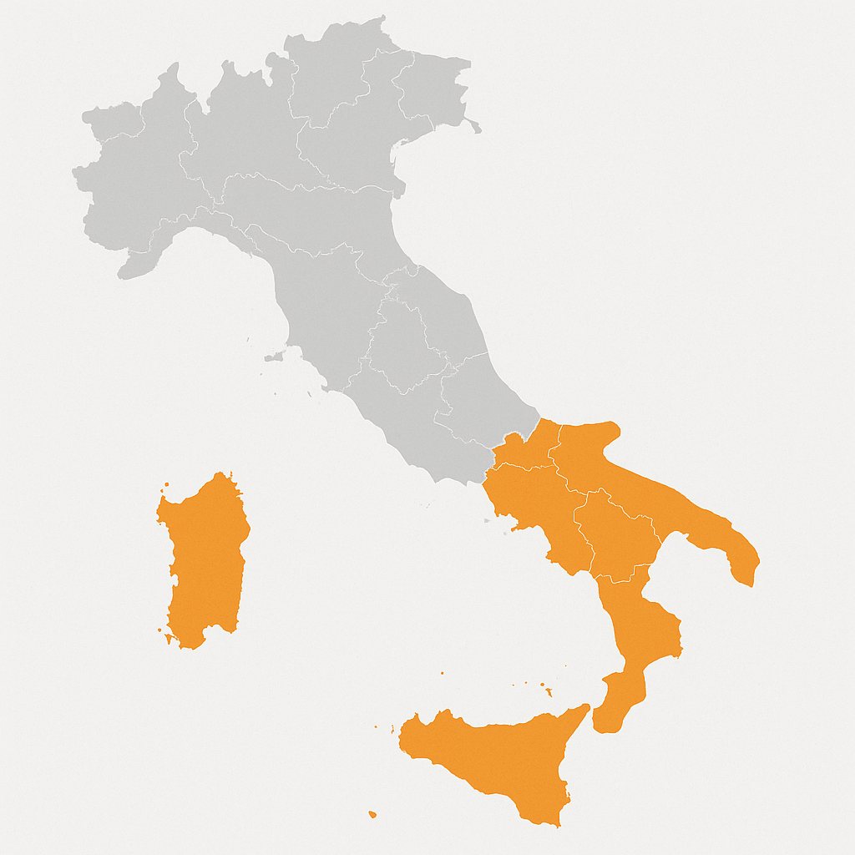






National Health Equity Program 2021-2027
360 million ESF+
7 weakest
Regions
in Italy
Health care for vulnerable people
Experimental
pathways
and models
Improvement of services organization
Improvement of health care professional skills

Slide 3
Strengths of our Communication Network
The local partner network (ASLs, regions, municipalities, third-sector and patient organisations, professional bodies, local media) turns national messages into something understandable, close to people and verifiable in daily life, while expanding audiences at no extra cost
Synergies between these networks are how we translate an equity mandate into real access to services. They extend reach to hard-to-reach groups without fragmenting the narrative, increase credibility through trusted local messengers, and shorten the distance between information and action by linking every message to a clear local access pathway.

Slide 4
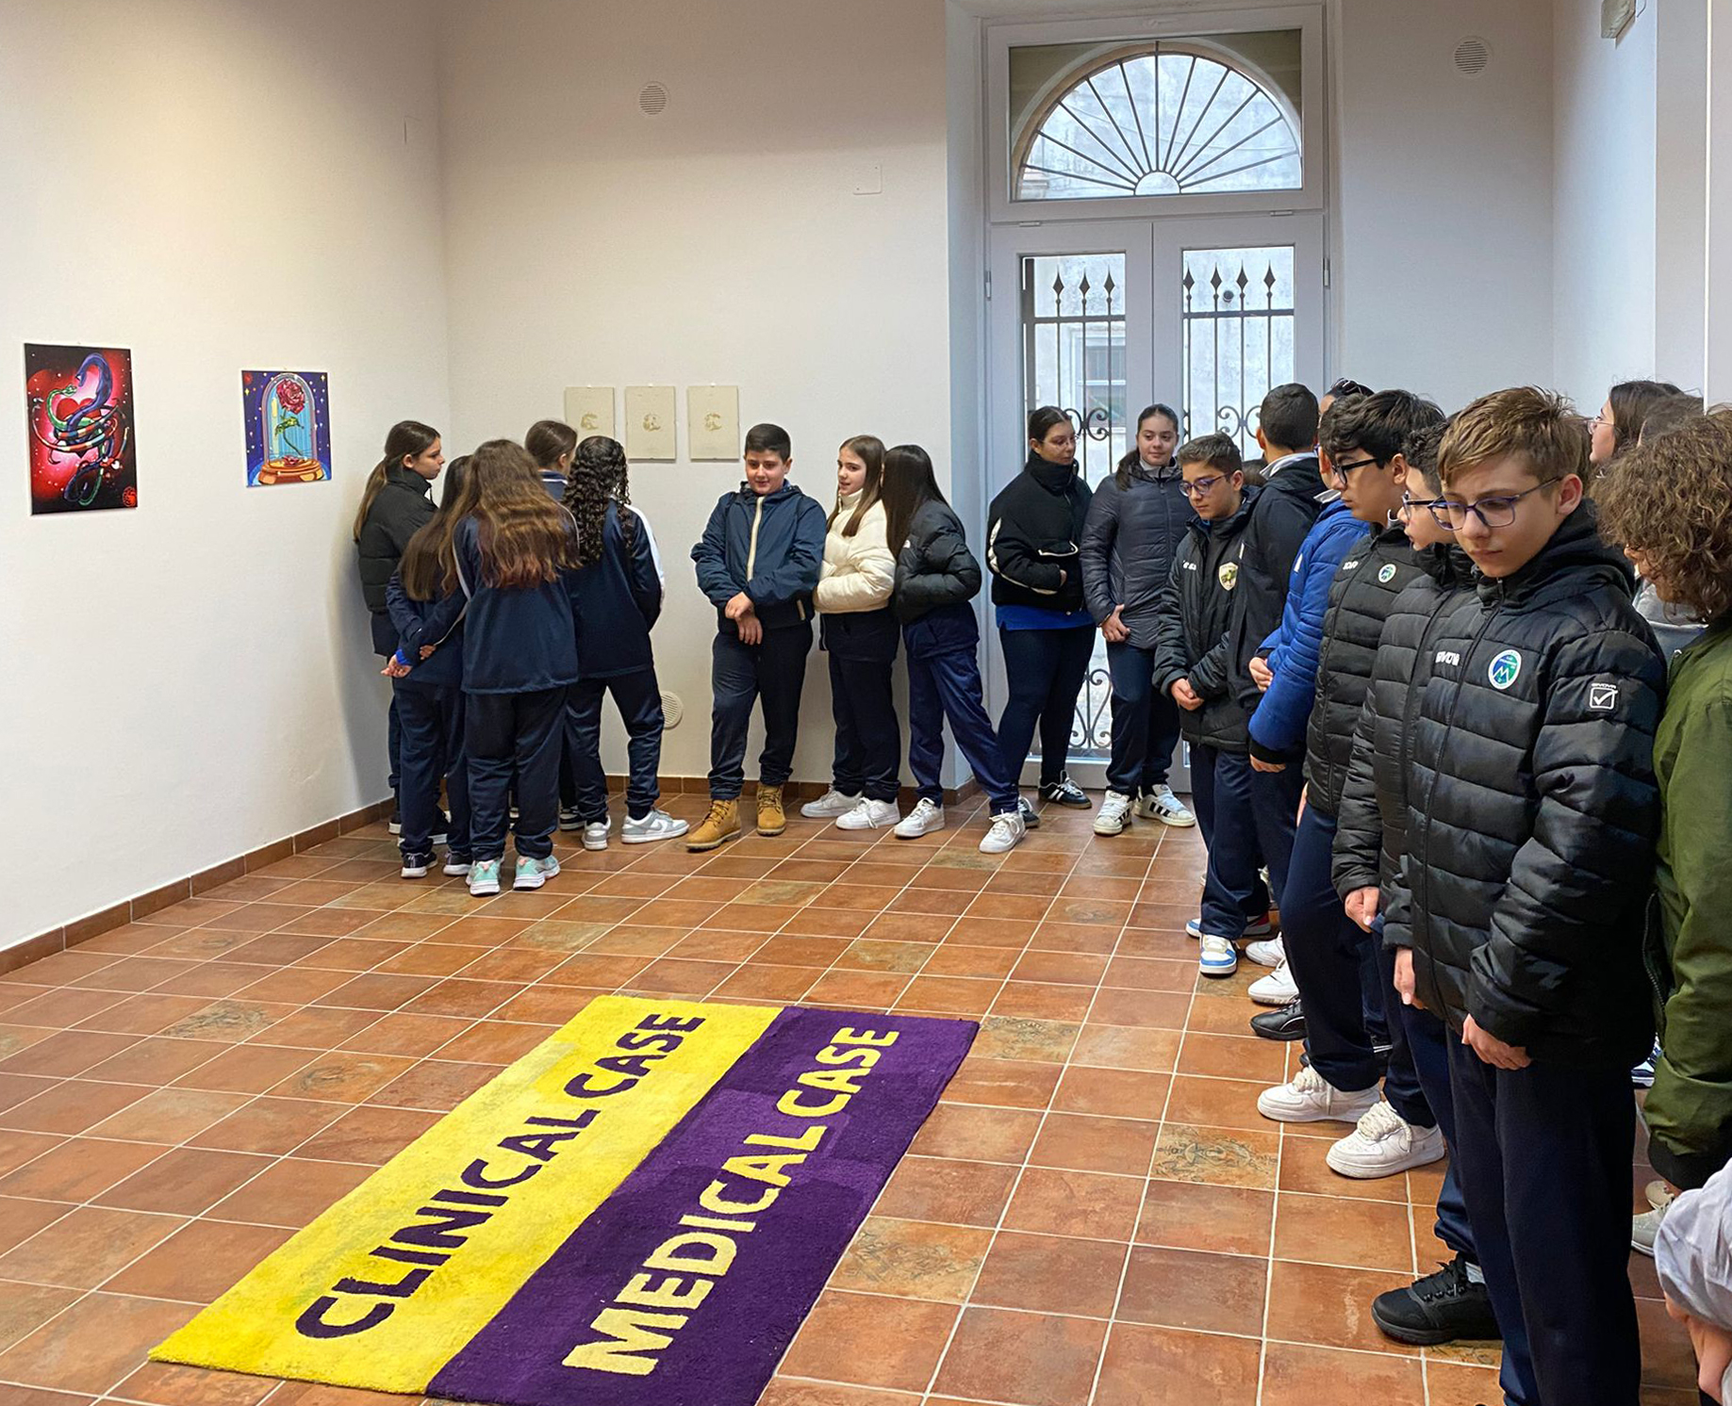
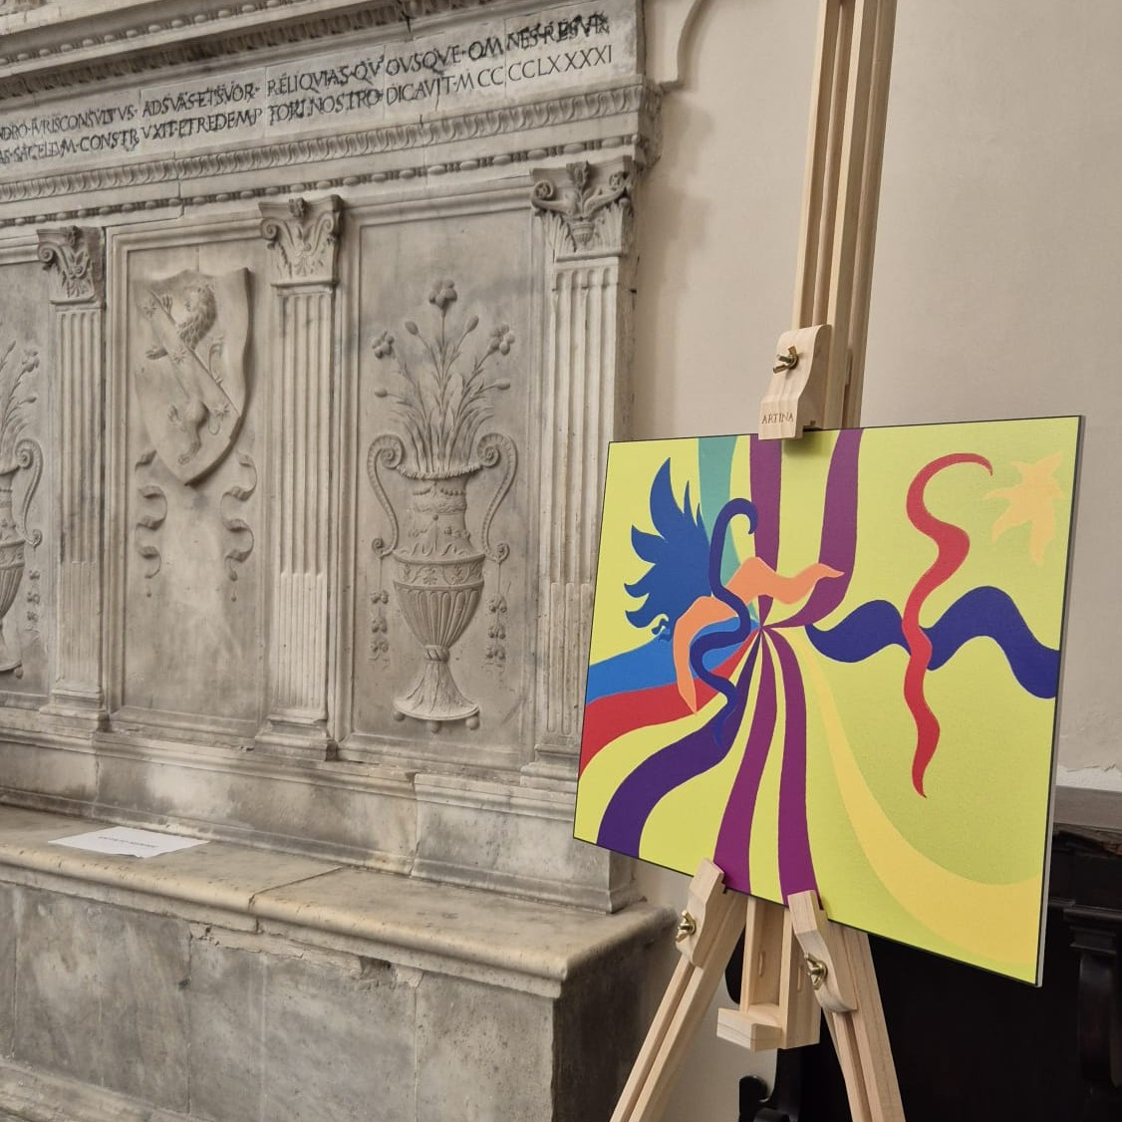
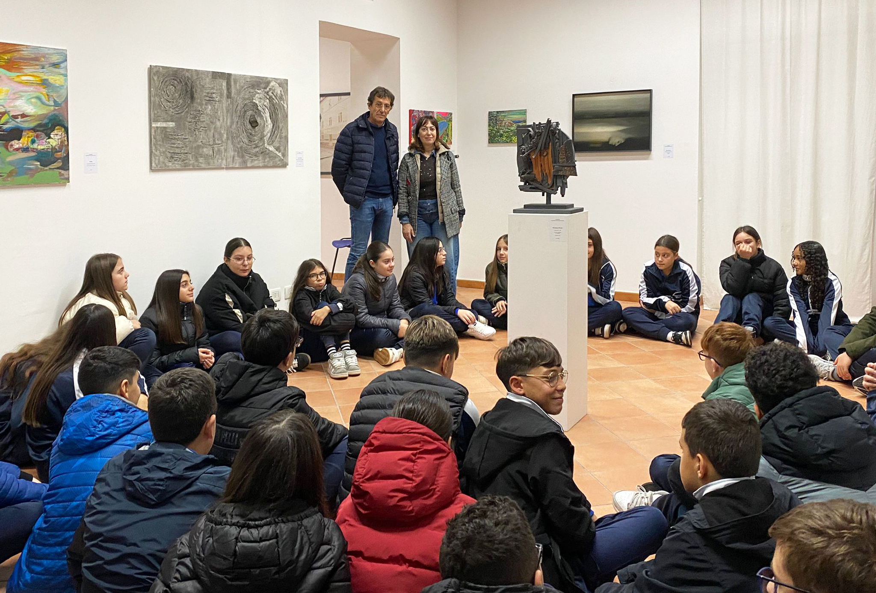
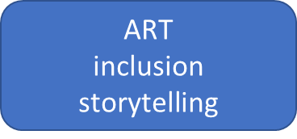
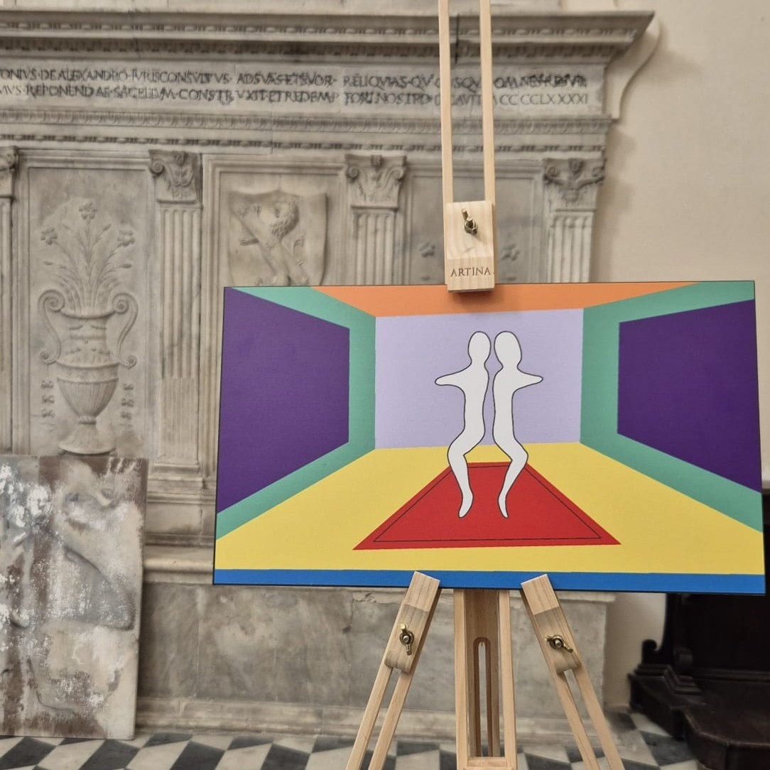
Sguardi Laterali (Sideways Perspectives): art, health and inclusion in Campania
Art has always been a universal language, capable of conveying emotions, experiences, and inner states.
Young talents and neurodivergent people
Ambassadors through their own creations
Stories of care pathways, relationships and rights
Awareness, empathy and active citizenship
Beneficiaries become the faces and content of our communication:
social media
local events and workshops that involve people and
associations, creating spaces for relationships and inclusion
shared storytelling
communication kit, a visual identity, and press materials
Many voices, one story!

Slide 5

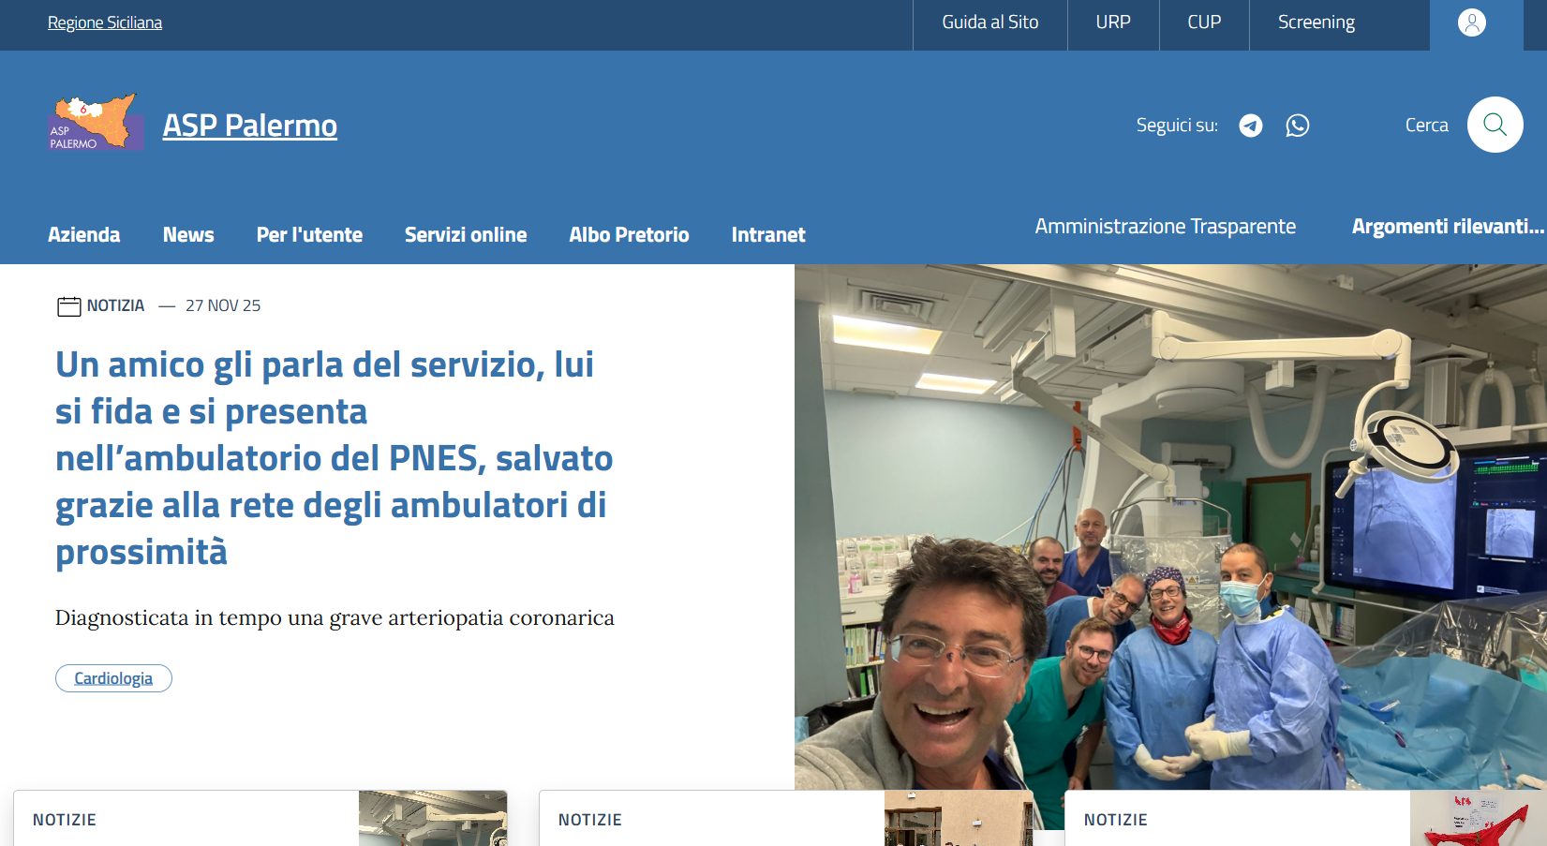

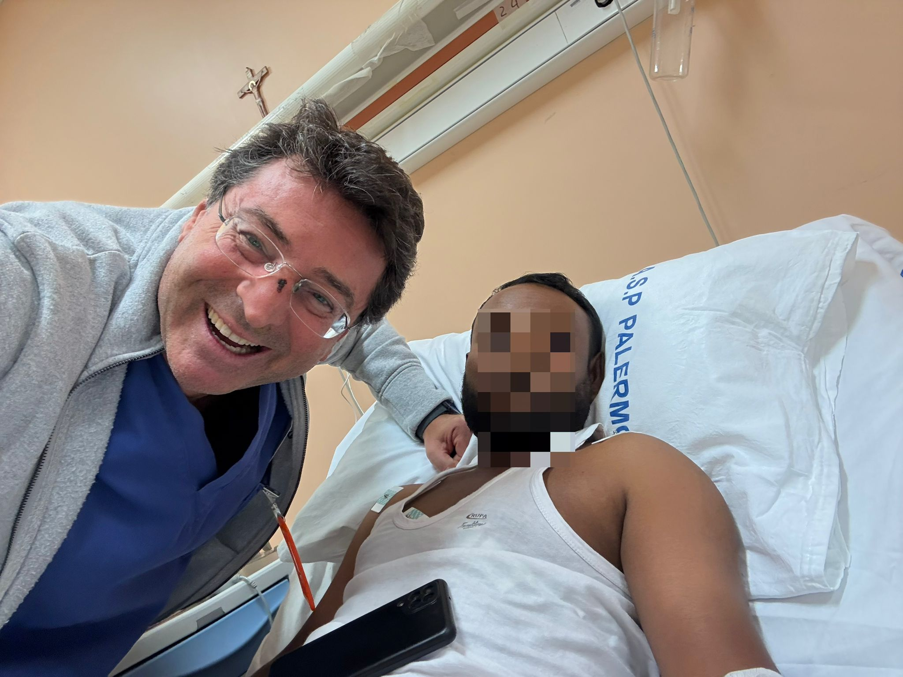
Case of M.M. - Palermo, 2025
What Happened | M.M., 37, from Bangladesh, living in Palermo, with limited resources. Atypical Chest Pain: Recurring and hard to interpret. Referred to the PNES Proximity Ambulatory via community word-of-mouth. Outcome: Timely intervention averted heart attack or sudden death.
Local Health Authority Communication | Channels Used: Publication on the official ASP website Sending press releases to local and national newspapers
Citizen’s Reaction | It is both a medical and a communication success Patient appreciated the communication effort Saw his case as helpful to others in fragile conditions Recognized value in sharing a successful example

Slide 6
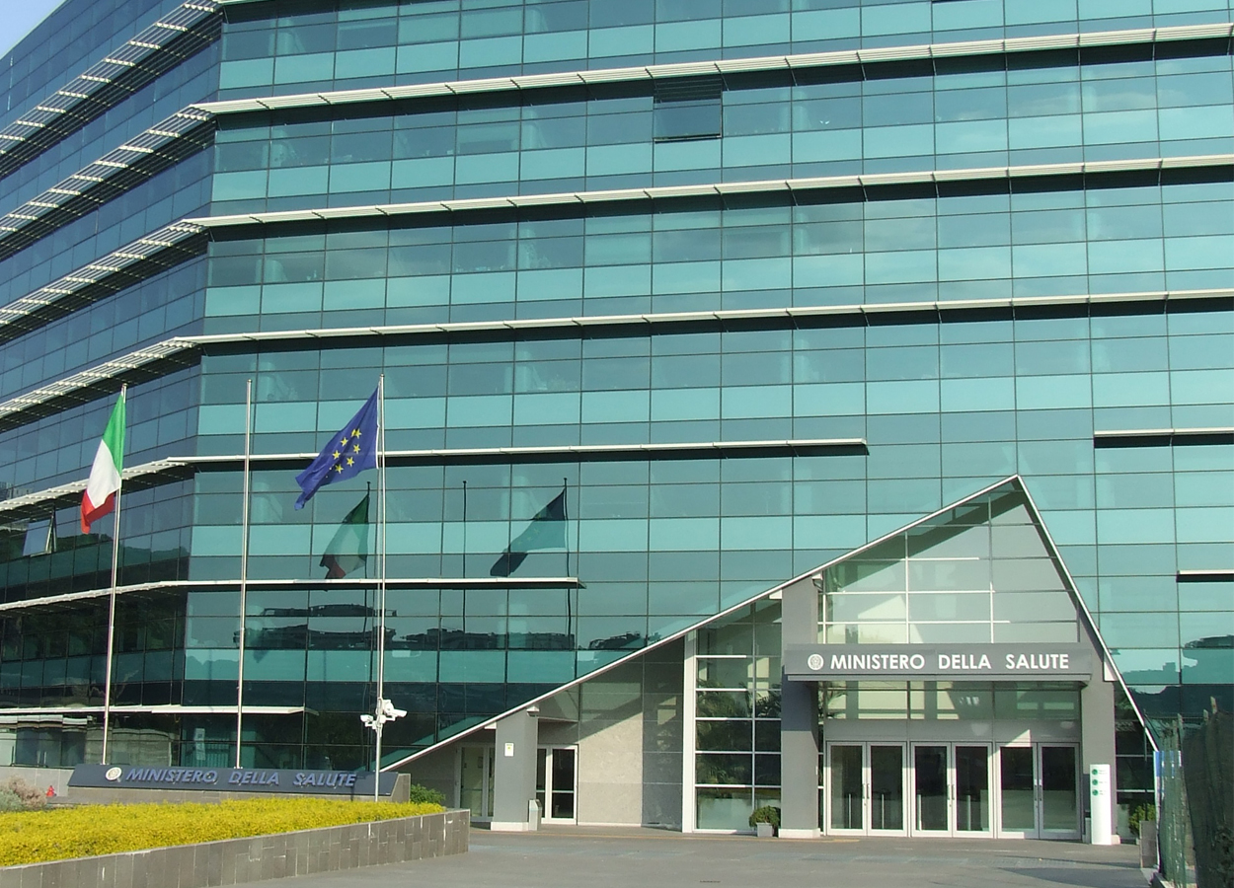
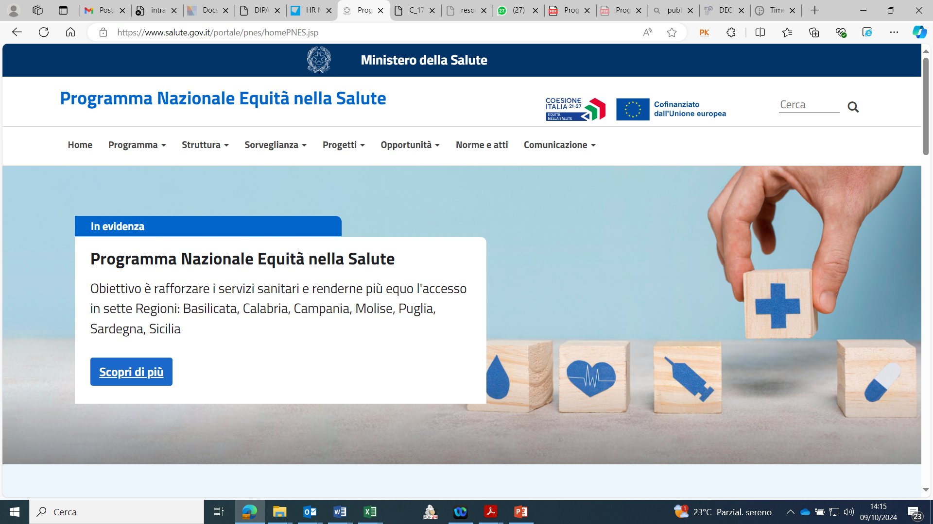
Thank you for your attention
and
Thank you Gdansk for hosting us!
pnequitanellasalute@sanita.it
https://www.pnes.salute.gov.it/portale/pnes/homePNES.jsp
6

